Slide 1
Other Balanced Trees, and an Unbalanced One (Huffman Encoding)
EECS 233

Slide 2
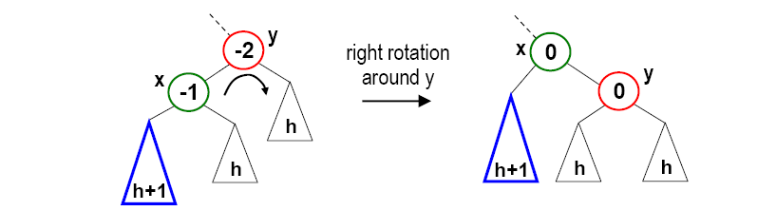
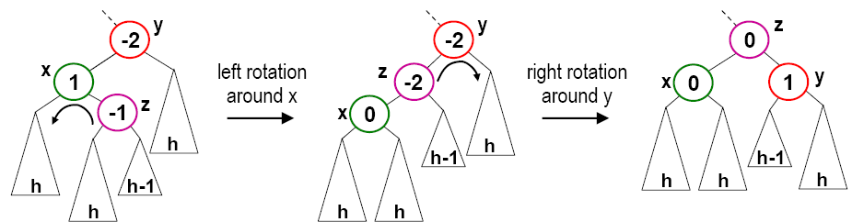
Previous Lecture
AVL trees (self-balancing binary tree)
Rotation operations: left rotation, right rotation, double rotation
h+1

Slide 3
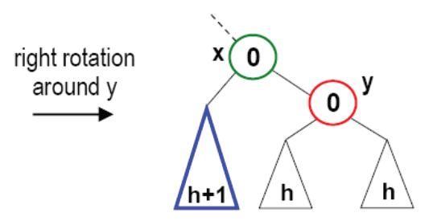
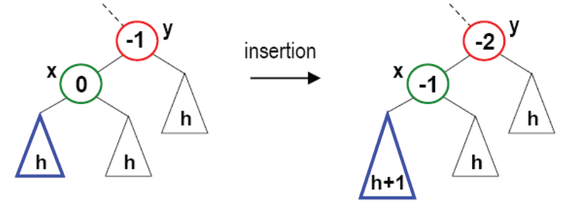
Previous Lecture: AVL Trees
AVL trees (self-balancing binary tree)
Insertion algorithm
  Insert a node, which may cause a change to balance values
  For each ancestor (from the leaf to the root), if the balance value
    changes from +/-1 to 0, DONE
    changes from 0 to +/- 1, go to the next ancestor
    changes from +/-1 to +/- 2, rebalance this tree, DONE
  How to balance the tree? If insertion occurred in the
    left-left subtree, do right rotation
    right-right subtree, do left rotation
    left-right subtree, do left-right double rotation
    right-left subtree, do right-left double rotation
insertion
h+1

Slide 4
Deletion from AVL Trees
Deletion may also cause unbalanced subtrees; if a deletion causes a change to the height, the ancestors need to be checked or balanced.
Deletion algorithm
  Remove the node (leaf or non-leaf, remember how it works?)
  Ultimately causes removal of a node X with 0 or 1 child
  May cause a change of the balance values for X’s parent
  For each ancestor (from X’s parent to the root), if the balance value
    changes from +/-1 to 0, what to do?
    changes from 0 to +/- 1, what to do?
    changes from +/-1 to +/- 2, what to do?
  To perform the balancing, use the same rotations as in insertion

Slide 5
Efficiency of AVL Trees
An AVL tree containing n items has a height that is O(log₂n).
Search and insertion are both O(log₂n).
  Search travels at most one path down the tree
  An insertion goes down one path to the insertion point, and then goes back up adjusting balances/performing rotations
    in the worst case, both the path down and the path back up consider O(log₂n) nodes
    each rotation requires a constant number of operations, and we perform at most two of them for a given insertion
Deletion begins with the same procedure used in binary search trees (O(log₂n) complexity). It can also require rotations to rebalance the tree, also at the complexity of O(log₂n).

Slide 6
Other Trees
2-3 trees
Splay trees
Red-black trees
B-trees

Slide 7
Aren’t AVL Trees Perfect?
AVL tree - binary balanced tree
  Searching an item requires traversing from root to (at most) leaf
  logN descents (random accesses)
  Visiting each node - one comparison.
On disk:
  Random access is expensive
  Disk read is in blocks (e.g. 4K bytes at once)
  Disk-based AVL trees waste much of a block for an internal node read
    The node is smaller than the block
    Payload of the node is not used
33
12
5
3
8
1
4
6
9

Slide 8
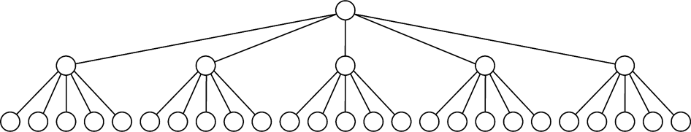
Designing for Disk Particulars
33
12
5
17
3
8
14
25
1
4
6
9
13
15
23
29
<7
[40-48)
[7-15)
[15-30)
[30-40)
1
3
4
5
6
8
9
12
13
14
15
17
23
25
29
33

Slide 9
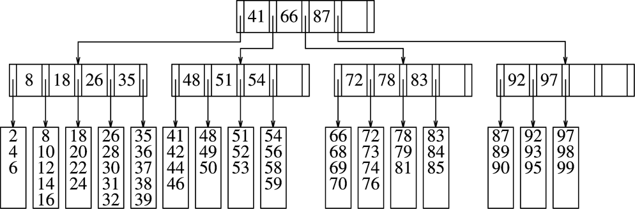
B-Tree Example
Order: branching M=5, items in leaf L=5
Example: search 74

Slide 10
B-Tree Example
A B-tree of order M is a balanced tree in which
  Each non-leaf node stores up to M-1 keys and M pointers; key i represents the smallest possible key in subtree i+1 at the next level
  Data items are stored in leaf nodes (L=maximum number of items.)
  Each node except for root is at least half full
    Non-leaf node: at least M/2 pointers
    Leaf node: at least L/2 entires
  The root is either a leaf, or has between 2 and M children
Determining M and L
  (M-1) * sizeof(key) + M * sizeof(pointer) <= Block size (e.g. 4KB)
  L * sizeof(item) <= Block size

Slide 11
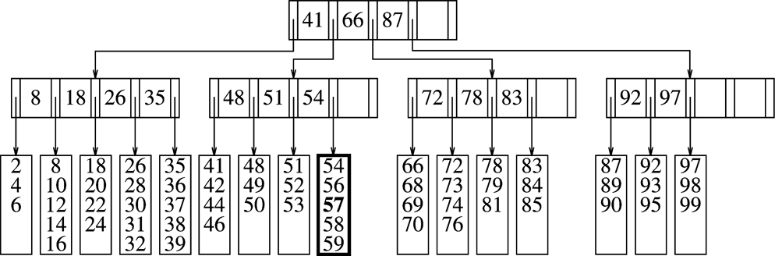
Insertion into B-Trees
First search for the key until we reach a leaf
Insert the key into the array of the leaf node
… assuming there is room
Insert 57

Slide 12
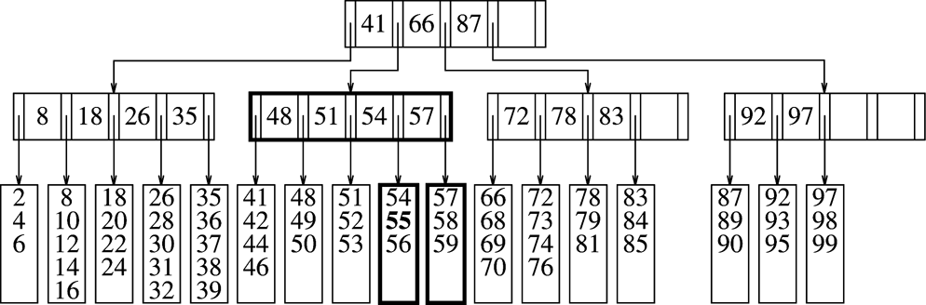
Leaf Split due to Insertion
Insert 55

Slide 13
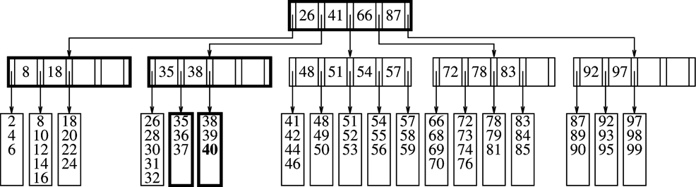
Splitting an Internal Node
Insert 40

Slide 14
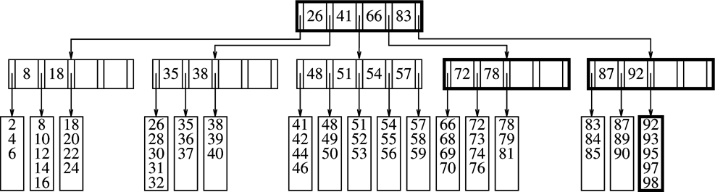
Deletion from B-trees: Node Merging
Remove 24?
Remove 35?
32
Remove 99:

Slide 15
Efficiency of B-Trees
Often measured by number of disk accesses, instead of CPU comparisons
How many disk accesses are required for each search/insertion/deletion?
CPU running time. Assume we use sorted array as the internal data structure of the nodes
  for search?
  for insertion/deletion?

Slide 16
Balanced or Unbalanced?
Balanced search trees provide bounded time complexity
  AVL trees
  B-trees
Many applications require quick access to the tree data structures, and balanced trees offer guaranteed performance
In other applications, we may not care if the tree is balanced or not, as our objective is not to save CPU time
Compression is an example (save disk storage space, save the size of network transfer, etc)
Example: Huffman encoding

Slide 17
Fixed-length Character Encoding
A character encoding maps each character to a number.
Computers usually use fixed-length character encodings.
  (Extended) ASCII (American Standard Code for Information Interchange) uses 8 bits per character.
    A : 01000001
    B : 01000010
    C : 01000011
    …
    We can represent this encoding with a binary tree (height=8)
  Unicode uses 16 bits per character to accommodate foreign-language characters. (ASCII codes are a subset.)
Fixed-length encodings are simple, because
  all character encodings have the same length
  a given character always has the same encoding

Slide 18
Variable-length Character Encoding
Problem: fixed-length encodings waste space.
Solution: use a variable-length encoding.
  use encodings of different lengths for different characters
  assign shorter encodings to frequently occurring characters
    E : 01
    O : 100
    S : 111
    T : 00
    TEST would be encoded as 000111100
Challenge: when decoding/decompressing an encoded document, how do we determine the boundaries between characters?
  example: for the above encoding, how do we know whether the next character is 2 bits or 3 bits?
Solution: no character’s encoding can be the prefix of another character’s encoding (e.g., couldn’t have T: 00 and Q: 001).

Slide 19
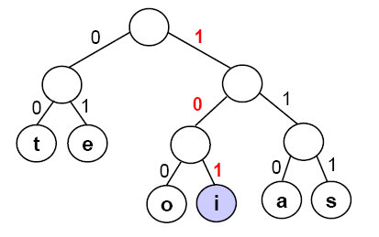
Huffman Encoding
Huffman encoding is a type of variable-length encoding that is based on the character frequencies in a given document.
Huffman encoding uses a binary tree:
  to determine the encoding of each character
  to decode an encoded file – i.e., to decompress a compressed file, putting it back into ASCII
Example of a Huffman tree (for alphabet with only six chars):
Leaf nodes are characters.
Left branches are labeled with a 0,
and right branches are labeled with a 1.
If we follow a path from root to leaf,
we get the encoding of the character in
the leaf. An example: 101 = ‘i’

Slide 20
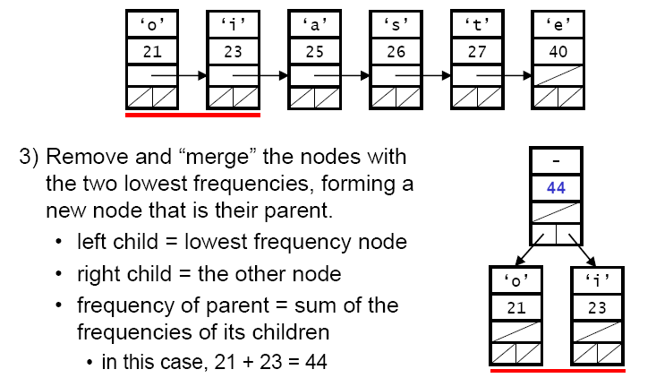
Building A Huffman Tree
Begin by reading through the text to determine the frequencies.
Create an (ordered) list of nodes that contain (character, frequency) pairs for each character that appears in the text.
Remove and “merge” the nodes with
the two lowest frequencies, forming a
new node that is their parent.
  left child = lowest frequency node
  right child = the next lowest frequency node
  frequency of parent = sum of the
  frequencies of its children

Slide 21
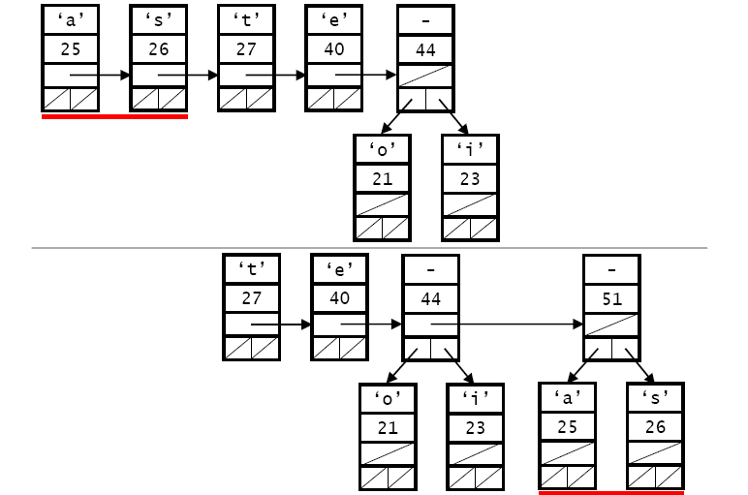
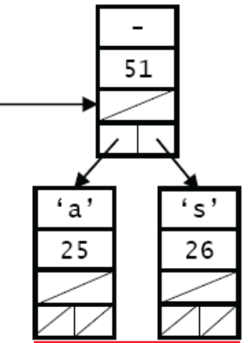
Building A Huffman Tree
Merge the two remaining nodes with the lowest frequencies:
  This is a greedy algorithm; a greedy algorithm attempts to get the optimal solution by finding currently the best move in each step

Slide 22
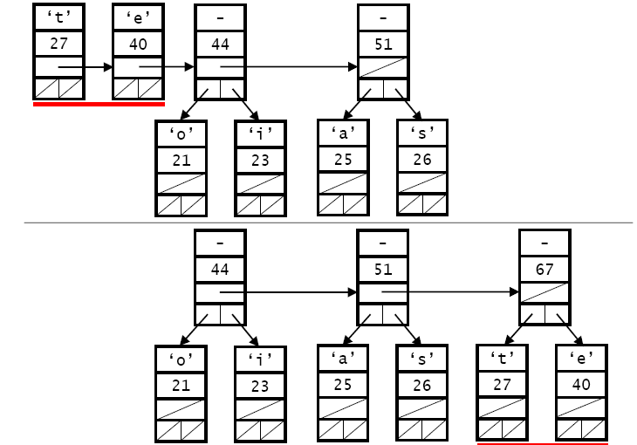
Building A Huffman Tree
It continues

Slide 23
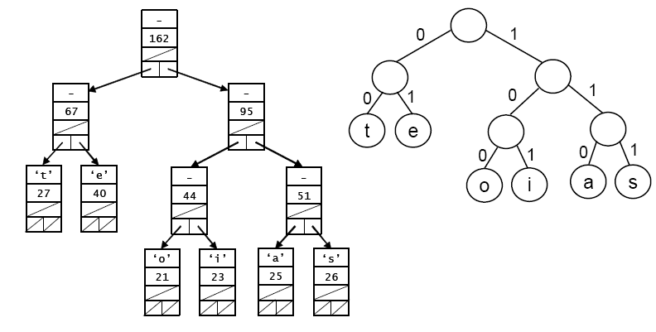
Building A Huffman Tree
The final tree, and character encoding

